Slide 1
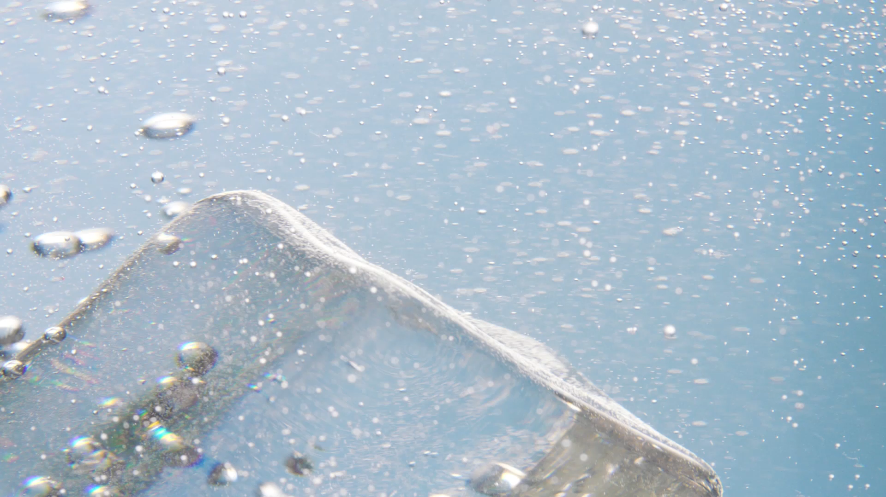
From Ice Cubes to Ice Spheres
Alberta “Albi” Kovatcheva

Slide 2
Scenario
Premier restaurants and bars are now serving drinks with ice spheres rather than ice cubes to chill the drink.
Suppose you work for an ice vendor, and are tasked with measuring the size of manufactured ice spheres.
Rather than measure the diameter directly, you weigh each sphere.
You consulted with your company's ice scientist, and they gave you a certain formula to convert the ice sphere's weight in grams to its diameter in inches (assuming it is weighed at 0 degrees Fahrenheit and is perfectly spherical); d is the sphere's diameter, and w is the sphere's weight.

Slide 3
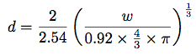
Weight to Diameter Formula for Ice Spheres
w = Weight in grams
d = Diameter in inches

Slide 4
Task
Create a function called diam() that computes the diameter of the sphere from its argument.
Create a for loop that will use your diam() function to compute the diameters of spheres with the following weights in grams: 0.96, 1.51, 2.17, 3.85, 4.45, and 6.02.

Slide 5
Formula in Code
#Weight (grams) to diameter (inches)
d = function(diam){
(2/2.54) * ((w / (0.92 * (4/3) * pi)) ^ (1/3))
}
#Weights in grams stored in vector 'w'
w = c(0.96, 1.51, 2.17, 3.85, 4.45, 6.02)
#For loop iterates over vector w containing weights of ice
for(i in w){
w2d = d(i)
}
print(w)
print(w2d)

Slide 6
Results
Weight (grams) | Diameter (inches)
0.96 | 0.495444
1.51 | 0.5761865
2.17 | 0.6502156
3.85 | 0.7871504
4.45 | 0.8260839
6.02 | 0.9136285

Slide 7
Summary of Results
The diameter of these ice spheres ranges from approximately 0.5 to 1 inches.
The weight of the ice spheres varies significantly, from approximately 1 to 6 grams.

Slide 8
Analysis
The sphere volume ranges from approximately 0.51 to 3.19 cubic inches.
The ice spheres were weighed at 0F = -17.778C, so their density is approximately 0.919456 g/cubic cm = 15.0672 g/cubic in.
In nature under the same conditions, their weights would range from 7.68 grams to 48 grams.
This formula might not be consistent with nature.

